Slide 1


Algorithms and Ordering Heuristics for
Distributed Constraint Satisfaction Problems
Lirmm,
Université Montpellier 2,
France
Limiarf, FSR
Université Mohammed V–Agdal, Maroc
Thèse de doctorat
Scpécialité : Informatique
Mohamed Wahbi
July 3rd, 2012

Slide 2
Outline
Background: CSP and Distributed CSP
Contributions:
  Nogood Based Asynchronous Forward Checking
  Asynchronous Forward Checking Tree
  Maintaining Arc Consistency Asynchronously
  Agile Asynchronous Backtracking
  DisChoco platform
Conclusions and perspectives

Slide 3
(Centralized) Constraint Satisfaction Problem - CSP
(X , D, C) where:
X is a set of n variables {x₁, . . . , x_{n}}
D = {D(x₁), . . . ,D(x_{n})} is a set of n domains,
  where D(x_{i}) is a finite set of possible values for variable x_{i}
C is a set of binary constraints, c_{ij} ⊆ D(x_{i})⨯D(x_{j})
Solution: combination of assignments of values to all variables in a way that all the constraints are satisfied.

Slide 4
Applications of Centralized CSP
Resource Allocation
Planning
Timetabling, nurse rostering
DNA sequencing
Circuit analysis
…
Notes:
4

Slide 5
Example of CSP: Graph Coloring Problem
One of the most common illustrations of CSPs
Color all nodes of a graph
Node: finite number of possible colors
Adjacent nodes: different colors
≠
x₁
x₂
≠
≠
≠
x₄
x₃
≠
Notes:
5

Slide 6
Solving CSP:
Forward Checking (FC)
  Typical backtrack search: variable instantiation with constraint propagation (prevents assignments that guarantee later failure)
  FC reduces the domains of future variables checking the constraints relating them to past variables
≠
Backtrack
to x₁
x₂=blue
x₁=green
x₂ = red
x₁ = red
x₁
x₂
≠
≠
≠
x₄
x₃
≠
Backtrack
to x₂
x₄ = red
x₃=blue
Notes:
6

Slide 7
Solving CSP:
Maintaining Arc Consistency (MAC)
  Foresees the effects of choosing an assignment on the on the future variables domains
  MAC checks also the constraints relating future variables to each other
≠
x₁=green
x₂ = red
x₁ = red
x₁
x₂
≠
≠
≠
x₄
x₃
≠
Backtrack
to x₁
x₄ = red
x₃=blue
Notes:
7

Slide 8
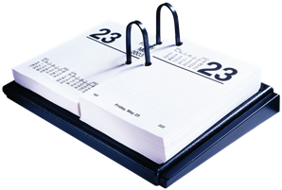


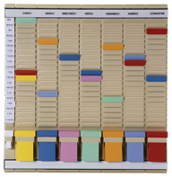





Distributed Meeting Scheduling Problem
Agent 4
M4₁
Agent 1
≠
M3₁
M4₄
M1₁
Meeting 4
=
=
Meeting 1
Meeting 3
=
M1₂
M4₃
≠
M3₃
≠
Agent 3
Agent 2
M2₂
=
Meeting 2
M2₃

Slide 9
Distributed CSP - DisCSP
CSP where variables and constraints are distributed among several agents.
(A, X, D, C) where:
A is a set of agents {A₁, ..., A_{p}}
X is a set of variables {x₁, . . . , x_{n}}
D = {D(x₁), . . . ,D(x_{n})} is a set of n domains
C is a set of binary constraints, c_{ij} ⊆ D(x_{i})⨯D(x_{j})
  We assume all agents hold exactly one variable (p = n)

Slide 10
Solving DisCSP
Agents must assign values to their variables so that all constraints are satisfied
Agents exchange messages about the variable assignments
Synchronous Search:
  Agents perform assignments in a sequential way
Asynchronous Search:
  Agents perform assignments asynchronously

Slide 11
The standard DisCSP synchronous algorithm:
Asynchronous Forward Checking (AFC)
Search: synchronous (Current Partial Assignment - CPA)
FC: asynchronous
Forward-Checking
Not_OK : [(x₁ ,v₁),…,(x_{i} ,v_{i})]
CPA:[(x₁ ,v₁);…;(x_{i} ,v_{i})]
CPA:[(x₁ ,v₁);…;(x_{j-1} ,v_{j-1})]
…
x_{j}
x₁
x_{i}
x_{i+1}
…
x_{j}
x_{k}
x_{n}
x_{k}
x_{n}
x_{k}
FC_CPA:[(x₁ ,v₁);…;(x_{i} ,v_{i})]
Back_CPA:[(x₁=v₁),…,(x_{i}=v_{i})]
CPA : ordered set of assignments
CPA = {[(x₁ ,v₁);…;(x_{i} ,v_{i})] | x₁≺ ··· ≺ x_{i} }
Empty domain
Notes:
11

Slide 12
The standard DisCSP asynchronous algorithm:
Asynchronous Backtracking (ABT)
  Agents are totally ordered: [A₁ , …, A_{i-1}, A_{i} , A_{i+1}, …, A_{n}]
    [A₁ , …, A_{i-1}] higher priority agents
    [A_{i+1}, …, A_{n}] lower priority agents
  Agents exchange messages (assignment/backtrack...)
  ABT is correct, complete and terminates
Notes:
12

Slide 13
The standard DisCSP asynchronous algorithm:
Asynchronous Backtracking (ABT)
  x_{i} informs a lower connected agent x_{k} of its assignment
  x_{k} evaluates the constraint, with its own assignment
  If permitted, no action
  Else, x_{k} looks for a value consistent with (x_{i} = v_{i})
    If it exists, assign it
    Else, backtrack
ok?(x_{i} = v_{i})
x_{i}
x_{k}
Backtrack
Notes:
13

Slide 14
Outline
Background: CSP and Distributed CSP
Contributions
  Nogood Based Asynchronous Forward Checking
  Asynchronous Forward Checking Tree
  Maintaining Arc Consistency Asynchronously
  Agile Asynchronous Backtracking
  DisChoco platform
Conclusions and perspectives

Slide 15
Basic concept: Nogood
If all the values of D(x_{k}) = {a, b, c} are removed
  x₁= v₁ ⇒ x_{k} ≠ a
  x_{i} = v_{i} ⇒ x_{k} ≠ b
  x_{j} = v_{j} ⇒ x_{k} ≠ c
A nogood is a partial assignment that cannot be extended to a solution
¬(x₁= v₁ ∧ x_{i} = v_{i} ∧ x_{j} = v_{j} )
can be rewritten as:
x₁= v₁ ∧ x_{i} = v_{i} ⇒ x_{j} ≠ v_{j}
x₁
x_{i}
x_{j}
x_{k}
Left Hand Side
Target

Slide 16
Nogood-based Asynchronous Forward Checking
AFC-ng
AFC-ng is based on AFC
AFC-ng uses nogoods as justifications of value removals
AFC-ng allows simultaneous backtracks going from different agents to different destinations
Notes:
16

Slide 17
Nogood-based Asynchronous Forward Checking
AFC-ng
Agent that detects dead-end :
no longer sends not_ok messages
sends ngd to the lowest agent in the resolved nogood
Nogoods | D(x_{k})
 | a
 | b
 | c
x₁ = v₁
x_{i} = v_{i}
x_{j} = v_{j}
CPA:[(x₁ ,v₁);…;(x_{i} ,v_{i})]
CPA:[(x₁ ,v₁);…;(x_{j},v_{j})]
ngd: […⟶ x_{i}≠v_{i}]
x_{i}
x_{j}
x_{k}
…
x_{n}
ngd:[x₁=v₁ ∧ x_{i} =v_{i} ⟶ x_{j} ≠ v_{j}]
Empty Domain
Notes:
17

Slide 18
Nogood-based Asynchronous Forward Checking
AFC-ng
A timestamp = [t₁, t₂, … , t_{i}]
The most up to date is the one which is lexicographically greater
t_{i} : counter that x_{i} increments whenever it changes its value
CPA:[(x₁,v₁,t₁);…;(x_{i} ,v_{i} ,t_{i})]
CPA:[(x₁,v₁,t₁);…;(x_{j} ,v_{j} ,t_{j})]
CPA:[(x₁,v₁);…;(x_{i} ,v_{i}’)]
CPA:[(x₁,v₁);…;(x_{j} ,v_{j}’)]
x_{i}
x_{k}
x_{i}
x_{j}
x_{j}
…
x_{n}
Notes:
18

Slide 19
Outline
Background: CSP and Distributed CSP
Contributions
  Nogood Based Asynchronous Forward Checking
  Asynchronous Forward Checking Tree
  Maintaining Arc Consistency Asynchronously
  Agile Asynchronous Backtracking
  DisChoco platform
Conclusions and perspectives

Slide 20
Asynchronous Forward Checking Tree (AFC-tree)
pseudo-tree arrangement of the constraint graph
multiple AFC-ng processes on the paths from the root to the leaves
Notes:
20

Slide 21
Asynchronous Forward Checking Tree (AFC-tree) from constraint graph to pseudo-tree
constraint graph (G)
pseudo-tree ordering
AFC-ng₁
AFC-ng₂
AFC-ng₃
AFC-ng₄
AFC-ng₅
A pseudo-tree = rooted tree with the same set of vertexes as G
Vertices in different branches of T do not share any edge in G
Notes:
21

Slide 22
Experiments
Algorithms:
  ABT, AFC,
  AFC-ng and AFC-tree
Uniform binary random DisCSPs
  sparse graphs ⟨n = 20, d = 10, p₁ = 0.2, p₂⟩
  dense graphs ⟨n = 20, d = 10, p₁ = 0.7, p₂⟩
Distributed sensor-target problems
Distributed meeting scheduling problems
The performance of the algorithms:
  computational effort (#ncccs)
  communication load (#msgs)

Slide 23
Experiments: sparse random DisCSPs
⟨n = 20, d = 10, p₁ = 0.2, p₂⟩ (constraint tightness varies)
#ncccs | #msg
AFC is the less efficient
AFC-ng improves AFC
AFC-tree takes advantage of the pseudo-tree
AFC dramatically deteriorates
AFC-tree has the smallest communication load

Slide 24
Experiments: dense random DisCSPs
⟨n = 20, d = 10, p₁ = 0.7, p₂⟩ (constraint tightness varies)
#ncccs | #msg
AFC-ng and AFC-tree outperform AFC
AFC-tree behaves like AFC-ng (pseudo-tree arrangement=a chain-tree)
ABT dramatically deteriorates

Slide 25
Experiments Summary
AFC-ng is always better than AFC (#ncccs and #msg)
AFC-tree is almost always better than or equivalent to AFC-ng
Sparse graphs: AFC-tree benefits from the structure
Dense graphs: AFC-tree runs on a chain-tree pseudo-tree and thus mimics AFC-ng
ABT suffers from too much asynchronism: AFC-ng seems to be the right compromise

Slide 26
Outline
Background: CSP and Distributed CSP
Contributions
  Nogood Based Asynchronous Forward Checking
  Asynchronous Forward Checking Tree
  Maintaining Arc Consistency Asynchronously
  Agile Asynchronous Backtracking
  DisChoco platform
Conclusions and perspectives

Slide 27
Maintaining Arc Consistency Asynchronously in Synchronous Search (MACA)
Instead of maintaining FC as in AFC-ng we propose to Maintain AC.
MAC checks also the constraints relating future variables to each other
MACA-del: using del messages
MACA-not: without additional kind of message
Notes:
27

Slide 28
Local Constraint Network
CSP(i): local constraint network?
A_{j}
A_{i}
A_{k}
x_{i}
x_{j}
x_{j}
x_{k}
x_{j}
x_{i}
x_{i}
x_{k}
x_{j}
x_{k}
x_{k}
x_{i}
Notes:
28

Slide 29
Maintaining Arc Consistency Asynchronously
(using del messages: MACA-del)
A_{j}
A_{i}
A_{k}
del:[nogoods on x_{i}]
x_{i}
x_{j}
x_{j}
x_{k}
x_{j}
x_{i}
x_{i}
x_{k}
x_{j}
x_{k}
x_{k}
x_{i}
CPA:[(x₁ ,v₁);…;(x_{h} ,v_{h})]
          A_{i} maintains AC on CSP(i)
  Dead-end on CSP(i), A_{i} backtracks
  Else, A_{i} propagates its deletions.
  Earlier detection of dead-end
  Agents can anticipate the backtrack operation
Notes:
29

Slide 30
Maintaining Arc Consistency Asynchronously
(without additional kind of message: MACA-not)
A_{j}
A_{i}
A_{k}
x_{i}
x_{i}
x_{j}
x_{j}
x_{j}
x_{i}
x_{k}
x_{k}
x_{j}
x_{k}
x_{i}
x_{k}
CPA:[(x₁ ,v₁);…;(x_{j} ,v_{j})]
CPA:[(x₁ ,v₁);…;(x_{j} ,v_{j})]+nogoods on x_{i}
CPA:[(x₁ ,v₁);…;(x_{j} ,v_{j})]+nogoods on x_{k}
A_{j} attaches nogoods justifying value removals from CSP(j) to the cpa message.
A_{j} attaches only removals relevant to A_{i}
  (i.e., variables in { CSP(j) ∩ CSP(i) } \ CPA } ).
Notes:
30

Slide 31
Experiments
Algorithms:
  AFC-ng,
  ABT-uac, ABT-dac [Brito and Meseguer, 2008],
  MACA-del and MACA-not
Uniform binary random DisCSPs
  ⟨n = 20, d = 10, p₁ = 0.25, p₂⟩
  ⟨n = 20, d = 10, p₁ = 0.70, p₂⟩
The performance of the algorithms:
  computational effort (#ncccs)
  communication load (#msgs)

Slide 32
Experiments: sparse random DisCSPs
⟨n = 20, d = 10, p₁ = 0.25, p₂⟩ (constraint tightness varies)
#ncccs | #msg
Algorithms enforcing an amount of arc consistency are better than AFC-ng
MACA-del is the fastest one.
MACA outperform ABT-dac and ABT-uac

Slide 33
Experiments: dense random DisCSPs
⟨n = 20, d = 10, p₁ = 0.70, p₂⟩ (constraint tightness varies)
#ncccs | #msg
Asynchronous algorithms are less efficient than synchrnous ones.
AFC-ng is the fastest algorithm.
Asynchronous algorithms require a large number of messages.
MACA-del does not improve on AFC-ng.
MACA-not is better than MACA-del

Slide 34
Experiments Summary
Synchronous: MAC is better than FC
  communication load: all problems
  computational effort: sparse network
MAC in synchronous algorithms is better than MAC in asynchronous ones.

Slide 35
Outline
Background: CSP and Distributed CSP
Contributions
  Nogood Based Asynchronous Forward Checking
  Asynchronous Forward Checking Tree
  Maintaining Arc Consistency Asynchronously
  Agile Asynchronous Backtracking
  DisChoco platform
Conclusions and perspectives

Slide 36
Dynamic Ordering Algorithms
In ABT the order of the agents is static
…Whereas dynamic reordering of variables is essential in centralized CSP solving
Existing poly-space techniques for dynamic ordering in ABT
  ABT_DO-ng and ABT_DO-Retro [R. Zivan, M. Zazone, and A.Meisels, 2009]
  But they allow only limited reordering
Notes:
36

Slide 37
Agile Asynchronous Backtracking
Agile-ABT
Asynchronous dynamic ordering algorithm
The order of agents appearing before the agent receiving a backtrack message can be changed
Agile-ABT ensures a polynomial space complexity
Termination Values: timestamp + reordering heuristic
Backtracking target: minimizing the termination value

Slide 38
Concept of termination value (TV)
order: o_{i} | A₁ | A₂ | … | A_{n}
Termination value: TV_{i} | d₁ | d₂ | … | d_{n}
Termination value: a tuple of domain sizes.
Termination value: timestamp exchanged among agents to compare orders
Order changed so that the termination value always decreases
→ Termination value = timestamp + reordering heuristic

Slide 39
Experiments
Algorithms:
  ABT
  ABT_DO-ng [Zivan and Meisels, 2006]
  ABT_DO-Retro-MinDom [Zivan et al., 2009] (Corrigendum, [Mechqrane et al. 2012])
  Agile-ABT
Uniform binary random DisCSPs
Distributed sensor-target problems
The performance of the algorithms:
  computational effort (#gncccs)
  communication load (#msgs)

Slide 40
Experiments: sparse random DisCSPs
⟨n = 20, d = 10, p₁ = 0.2, p₂⟩ (constraint tightness varies)
#gncccs | #msg
ABT is the less efficient algorithm
Agile-ABT outperforms other algorithms
ABT requires less messages than ABT_DO-ng and ABT_DO-Retro
Agile-ABT is the algorithm that requires the smallest number of messages

Slide 41
Experiments: dense random DisCSPs
⟨n = 20, d = 10, p₁ = 0.7, p₂⟩ (constraint tightness varies)
#gncccs | #msg
ABT_DO algorithms deteriorate compared to ABT.
Agile-ABT still outperforms all these algorithms.
ABT_DO-ng and ABT_DO-Retro show the same bad performance.
Agile-ABT shows similar communication load as ABT.

Slide 42
Experiments Summary
computational effort
  sparse instances: Reordering algorithms are better that ABT
  dense instances: ABT_DO algorithms deteriorate compared to ABT.
  Agile-ABT is more parsimonious than ABT_DO algorithms in proposing new orders
communication load
  ABT_DO algorithms require more messages than ABT
  Agile-ABT exchanges almost always fewer messages than ABT

Slide 43
Outline
Background: CSP and Distributed CSP
Contributions
  Nogood Based Asynchronous Forward Checking
  Asynchronous Forward Checking Tree
  Maintaining Arc Consistency Asynchronously
  Agile Asynchronous Backtracking
  DisChoco platform
Conclusions and perspectives

Slide 44
Why a distributed constraint solver?
Problems from DAI
Modelling as DCN
Solving using DCR techniques
Problems from Distributed Artificial Intelligence:
Sensor Networks
Distributed Meeting Schedulling
…
Modelling as a Distributed Constraint Network (DCN):
Distributed CSP (DisCSP)
Distributed COP (DCOP)
Solving problems using a Distributed Constraint Reasoning protocol:
ABT [Yokoo et al.,92]
AFC[Meisels et al., 03]
Adopt [Modi et al., 05]
…

Slide 45
Why a DCR framework?
Programming DCR algorithms is a difficult task
  centralized programming
  distributed programming
  asynchronous and concurrent management of distributed structures
  others
Few open-source tools for solving DCR problems:
  DCOPolis (Simple agents + DCOP)
  FRODO (Complex agents + DCOP)
  DisChoco

Slide 46
DCR framework features
Reliable and modular: easy to personalize and extend
Independent from the communication system
Allow the simulation of multi-agent systems on a single machine
Implement a real distributed framework
Allow agents with local constraint network (Choco as local solver) (p ≠ n)

Slide 47
Definition of a distributed problem using DisChoco 2.0: Java code
ABT [Yokoo et al.,92]
ABT-Hyb [Brito et al. 04]
ABT-dac[Brito et al. 08]
DisFC [Brito et al. 03]
AFC [Meisels et al., 03]
AFC-ng [Ezzahir et al., 09]
AFC-Tree [Ezzahir et al., 09]
ABT-cf [Ezzahir et al., 07]
DBA [Yokoo et al., 00]
Adopt [Modi et al., 05]
…

Slide 48
Definition of a distributed problem using DisChoco 2.0: XML format
Adopted by
Frodo 2.0

Slide 49
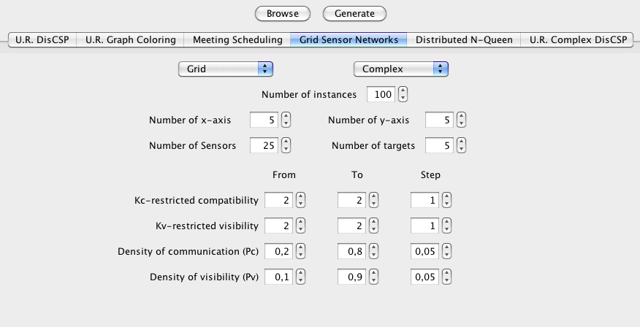
The Graphical User Interface (GUI):
(1) Experimentations

Slide 50
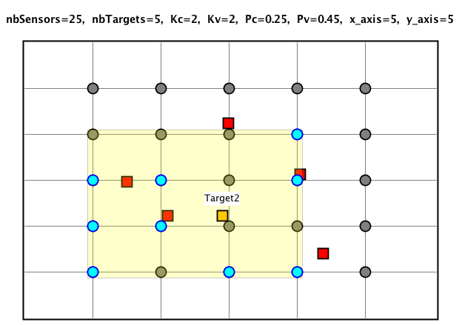
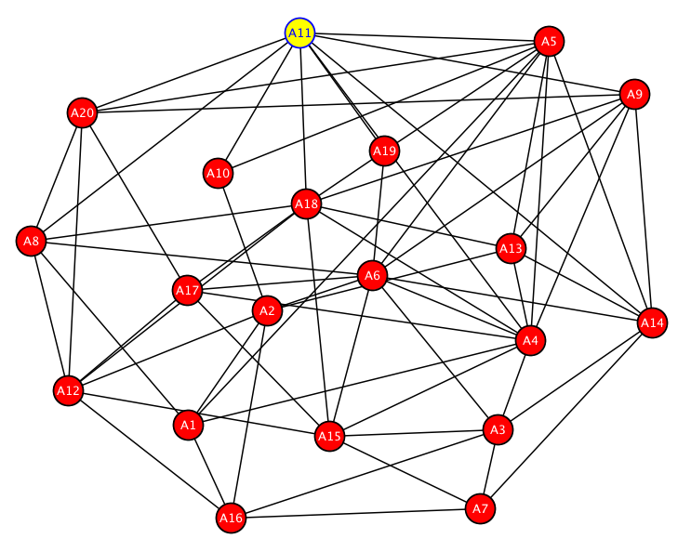
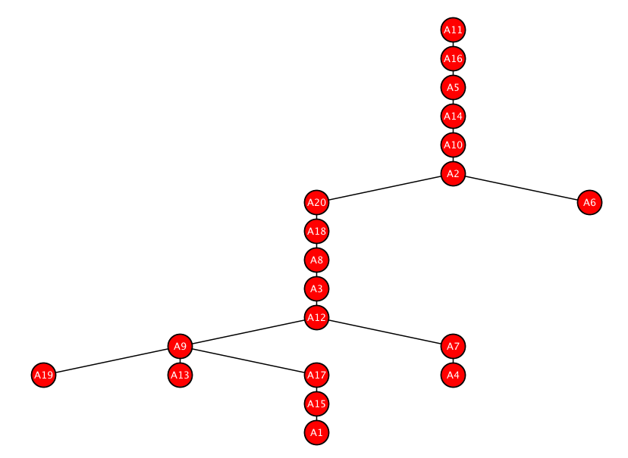
The Graphical User Interface (GUI):
(2) Visualizing problems
Sensor-Target
Constraint Graph
Tree

Slide 51
DisChoco 2.0
Total Lines of Code: 48265
Number of Methods: 3987
Number of Classes: 430
Number of Packages: 70

Slide 52
Outline
Background: CSP and Distributed CSP
Contributions
  Nogood Based Asynchronous Forward Checking
  Asynchronous Forward Checking Tree
  Maintaining Arc Consistency Asynchronously
  Agile Asynchronous Backtracking
  DisChoco platform
Conclusions and perspectives

Slide 53
Conclusions
Synchronous Search
  AFC-ng: nogoods allow concurrent backtracks
  AFC-tree: pseudo-tree
  MACA: AC instead of FC
Asynchronous Search
  Agile-ABT: dynamic ordering algorithm without standard restrictions (poly-space)
  Corrigendum: of ABT_DO-Retro.
Solver
  DisChoco 2.0
Notes:
53

Slide 54
Perspectives
Synchronous Search
  Reordering heuristics for AFC-ng and MACA
  AFC-tree on different kinds of pseudo-trees
Asynchronous Search
  Agile-ABT is a framework for implementing other heuristics (dom/deg and the dom/wdeg, …): termination value = timestamp + heuristic
Notes:
54

Slide 55
Thank you

